Slide 1
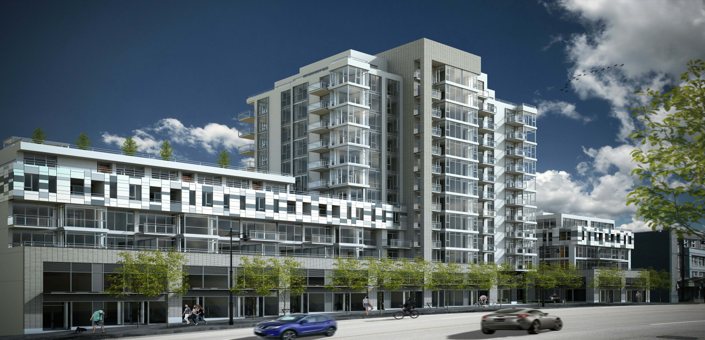

Slide 2
COMING FALL 2018 THE WINDSOR ON A PROMINENT EAST VAN REIDGE WITH SWEEPING MOUNTIAN AND CITY VIEWS, A NEW COLLECTION OF 1, 2 AND 3 BEDROOM HOMES IS RISING.

